Slide 1
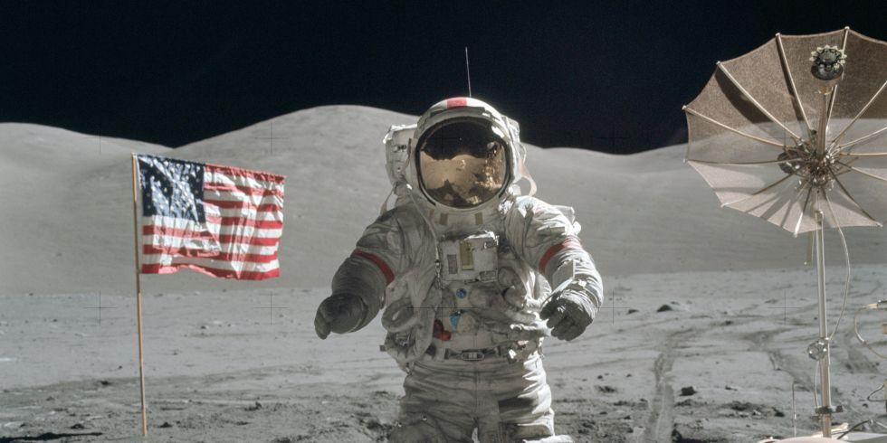
1st Woman on the Moon

Slide 2
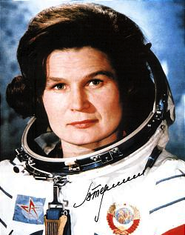
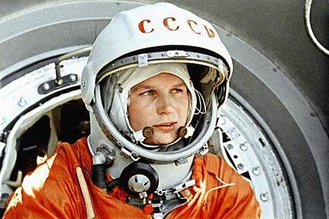
Valentina Tereshkova First Woman in Space June 16, 1963
Notes:
They didn’t fly another woman, Svetlana Savitskaya, till 19 years later in 1982 (just before Sally Ride’s flight). She became the 1st woman to do a space walk. They then flew their third woman, Yelena Kondakova in 1994. There have only been 4 Russian women in space to date vs 50 for the US

Slide 3
Sally Ride- June 18, 1983

Slide 4
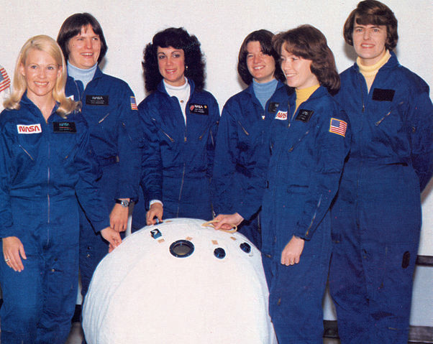
Rhea Kathy Judy Sally Anna Shannon
1978
Seddon Sullivan Resnik Ride Fisher Lucid
Notes:
In 1978, The US selected their first class of female astronauts. As a kid I assumed it was just because NASA was catching up with the times and saw that they should start including women in the new Shuttle program.

Slide 5
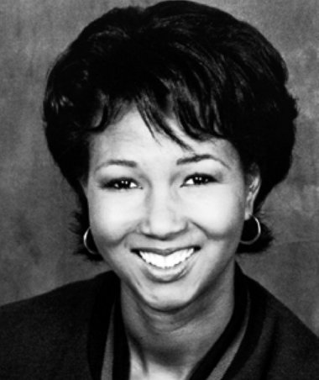
Mae Jemison- Sept 15, 1992
“An Inclusive Audacious Journey Transforms Life Here on Earth and Beyond.”
Notes:
1992
Spoke at my graduation in 1996

Slide 6
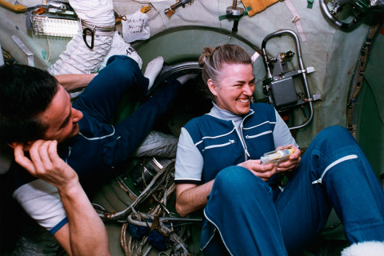
Shannon Lucid- 1996
She spend over 6 months on Space Station MIR and used her charm and grace to look on the bright side of everything.

Slide 7
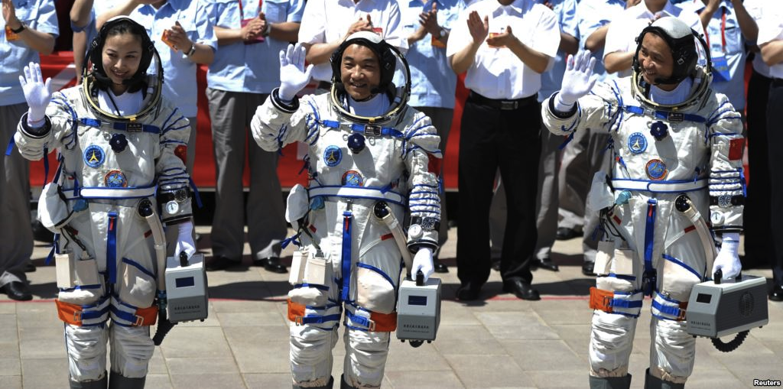
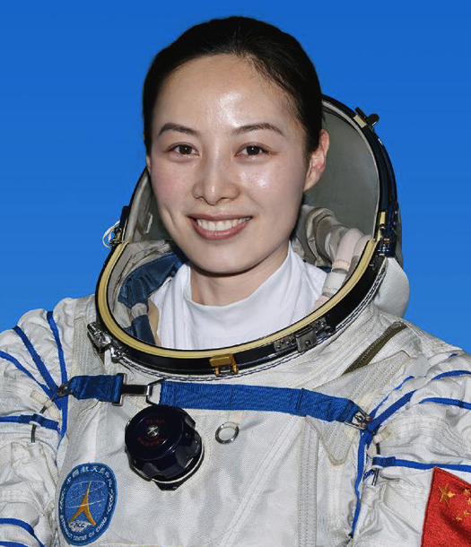
Wang Yaping launched June 11, 2013 57th woman in space
Notes:
Last week on June 11th, China’s 2nd female astronaut Wang Yaping, became the 57th women to go to space. She is the first person to go into space who was born in the 80’s! (just barely). She would have been only 5 months old at the time of Sally’s 1st flight

Slide 8
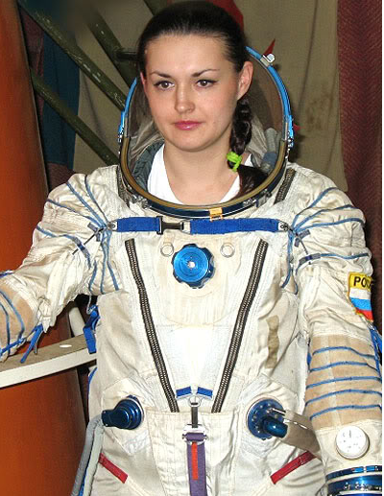
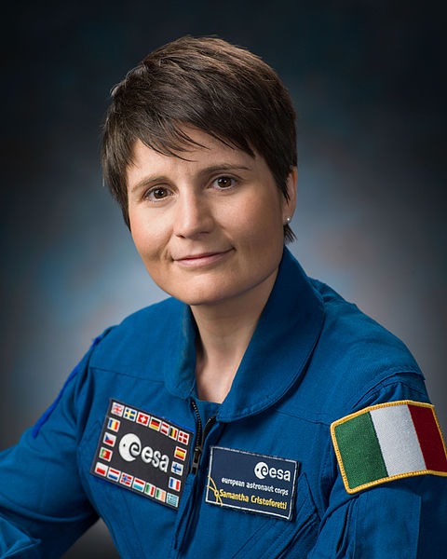
Launched Sept and Nov 2014: 58^{th &} 59th woman in space
Yelena Serova
Samantha Cristoforetti
Notes:
Yelena Serova Samantha Cristoforetti

Slide 9
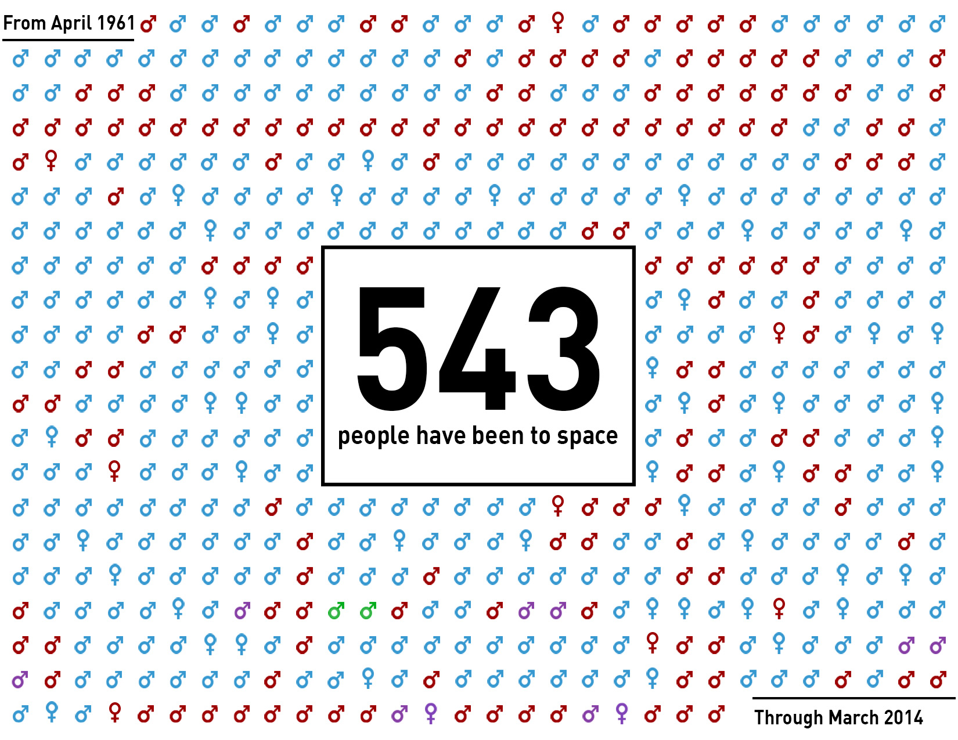

Slide 10
60
Women

Slide 11
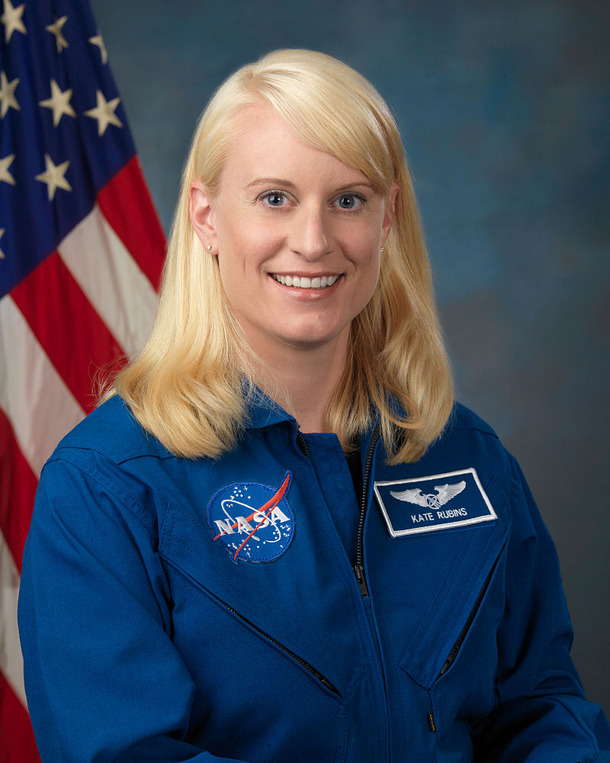
Kate Rubins launched June ‘17 60th woman in space
Kate Rubins
Notes:
Yelena Serova Samantha Cristoforetti

Slide 12
Eight Stanford Women Have Been in Space

Slide 13
Why Does It Matter?
Mixed genders teams behave better (in our current culture)
Woman often have a valuable perspective (or more cultural space to express it)
Women can help us connect half our population to space

Slide 14
What You Can Do
Read Sheryl Sandberg’s Lean In
Weaken the Imposter Syndrome by talking openly about your own experience
Have women sitting at the table in meetings/panels
Hire and mentor women
Notes:
Nearly 10% of Galactic’s 700 customers are women- which means that we could easily double the number of women who have been to space over the next few years…

Slide 15
Notes:
Five hours of weightless time, we fly out of KSC, Las Vegas, Moffett and whereever anyone will pay to bring us. Northrop flies math and science teachers- so be sure to tell a deserving teacher! NASA Flies Students- I saw that Jake was talking about putting together a team- I highly recommend it.

Slide 16
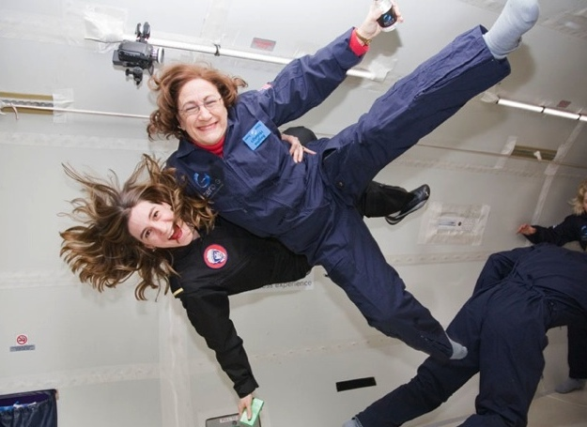
Notes:
Five hours of weightless time, we fly out of KSC, Las Vegas, Moffett and whereever anyone will pay to bring us. Northrop flies math and science teachers- so be sure to tell a deserving teacher! NASA Flies Students- I saw that Jake was talking about putting together a team- I highly recommend it.

Slide 17
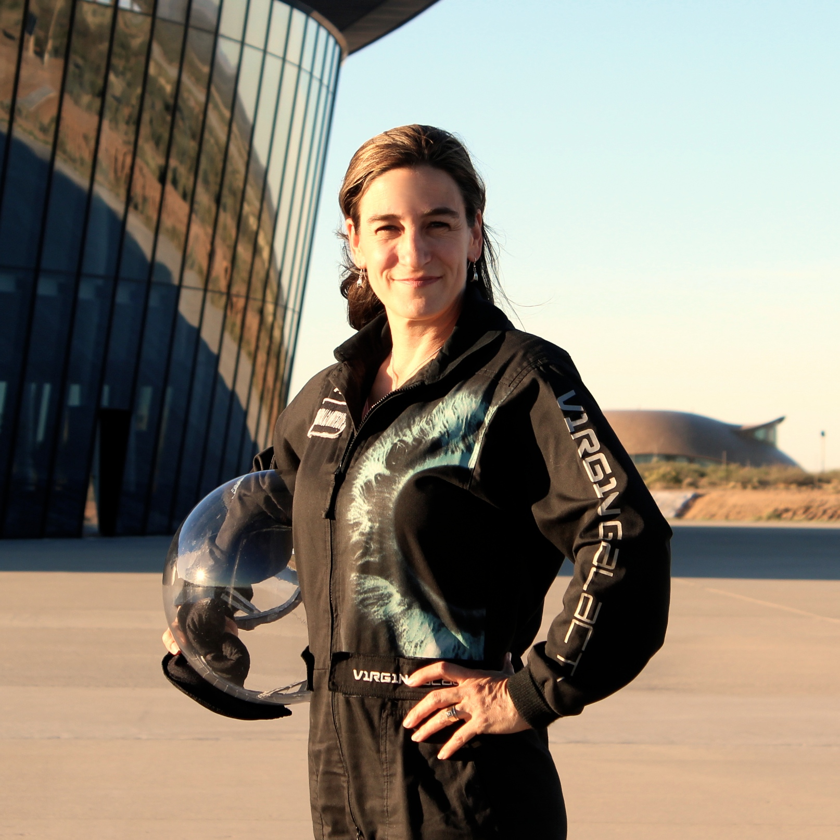
Notes:
Five hours of weightless time, we fly out of KSC, Las Vegas, Moffett and whereever anyone will pay to bring us. Northrop flies math and science teachers- so be sure to tell a deserving teacher! NASA Flies Students- I saw that Jake was talking about putting together a team- I highly recommend it.

Slide 18
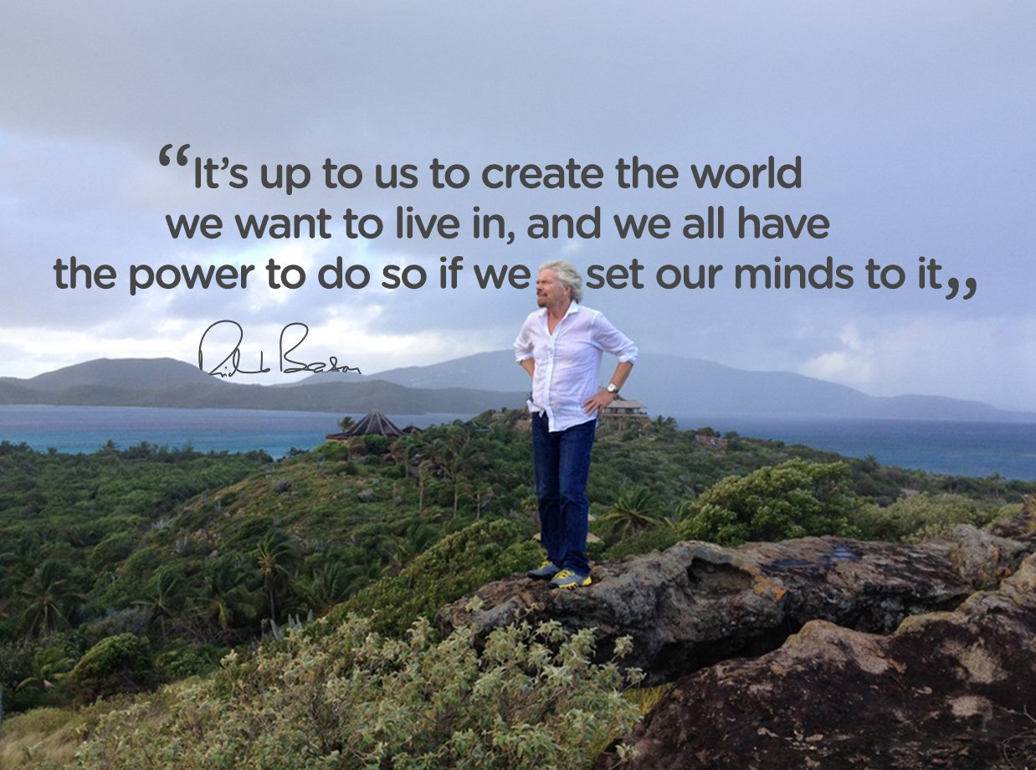
Notes:
We are fortunate to have a very visionary and thoughtful founder.

Slide 19
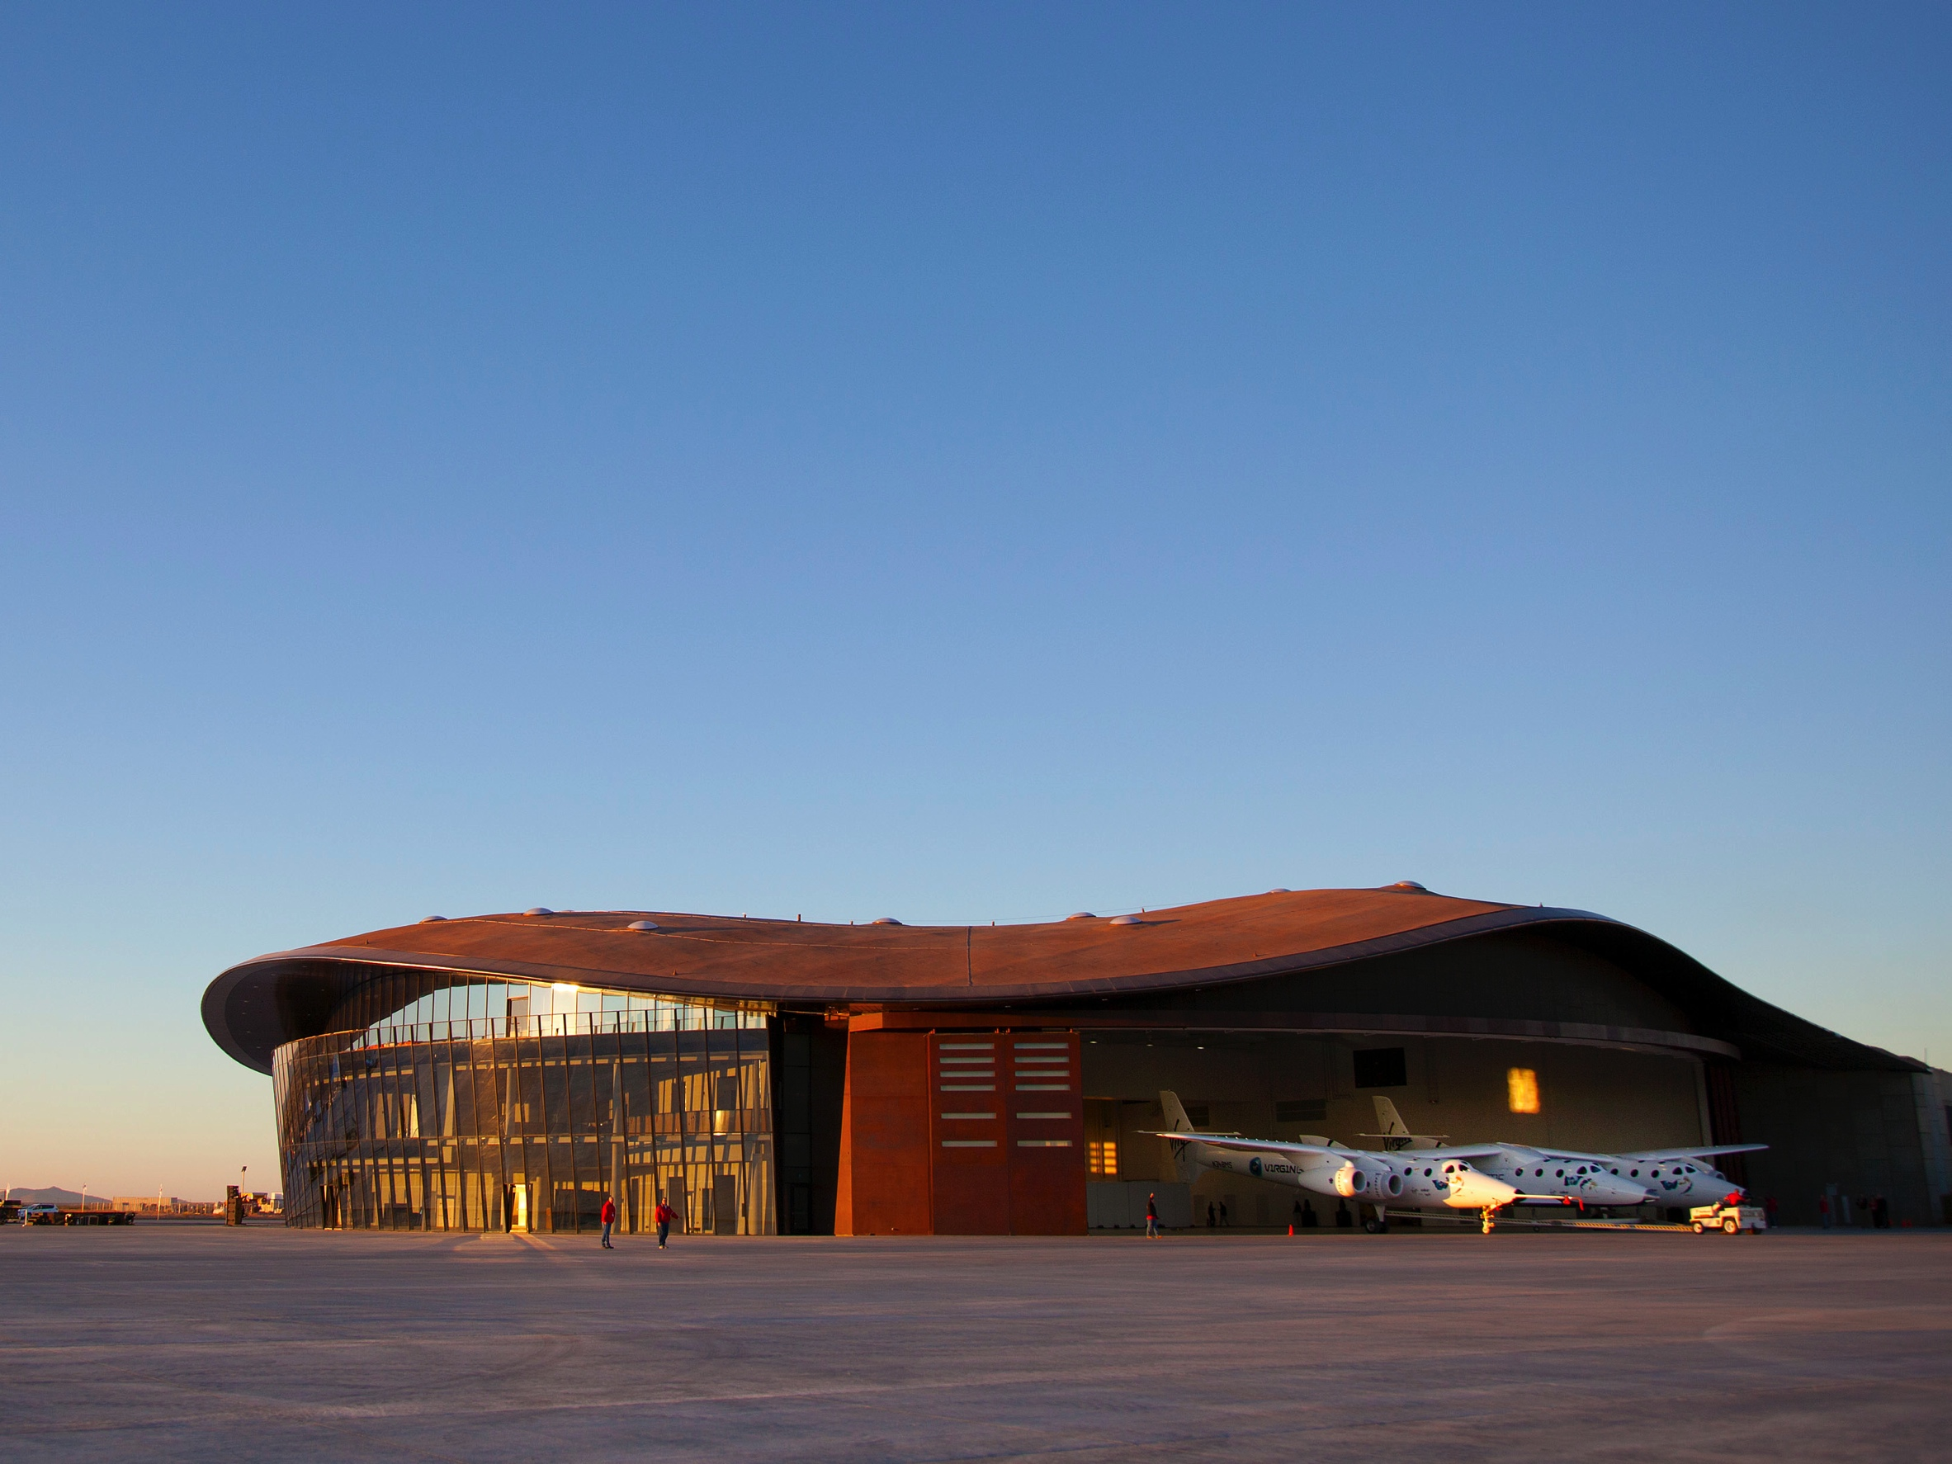

Slide 20
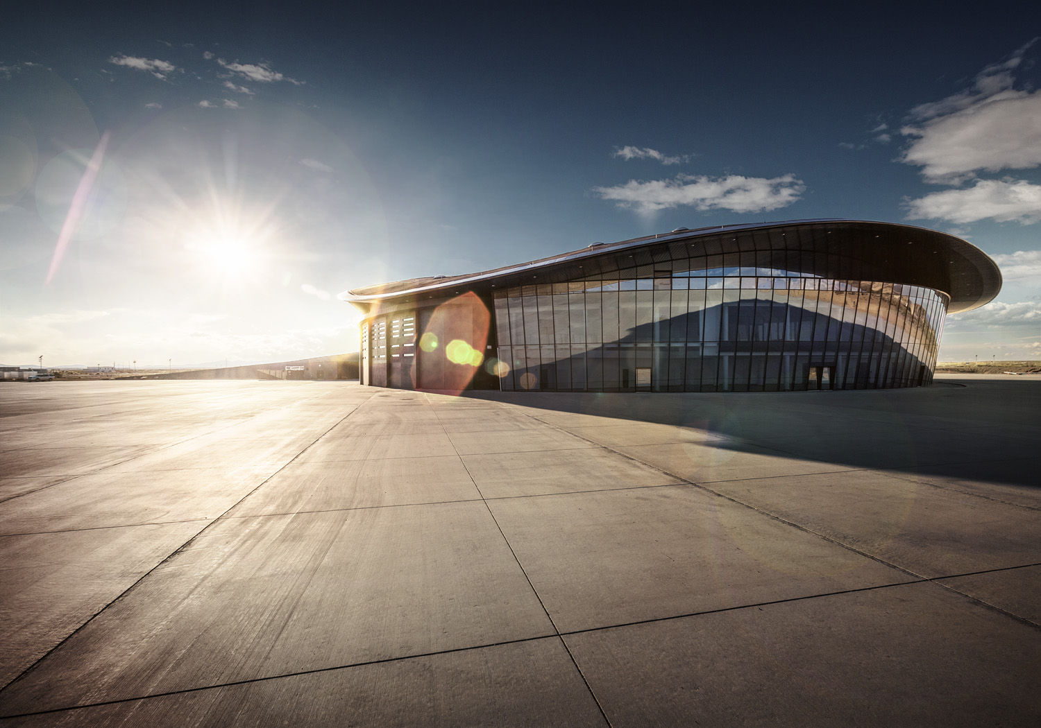

Slide 21
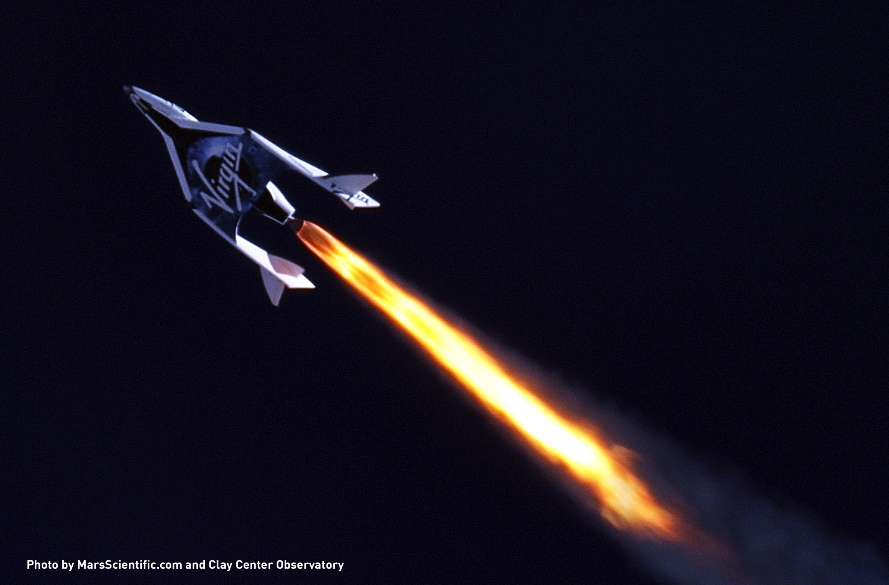

Slide 22
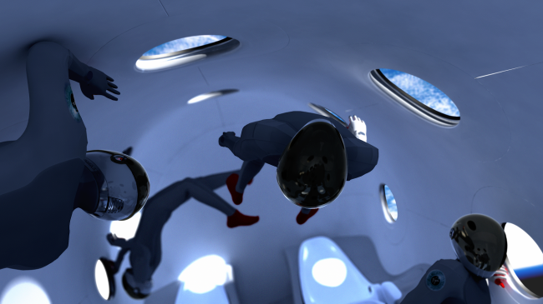

Slide 23
Follow your dreams, and you will give others the courage to follow theirs
Stanford- B.S. Biology, 1996
Loretta.whitesides@gmail.com
@lorettahidalgo

